Slide 1



Cmpe 422 – Database Systems 2017 Fall

Slide 2
Cmpe 422 – Database Systems 2017 Fall

Slide 3

What is JSON?
Cmpe 422 – Database Systems 2017 Fall

Slide 4
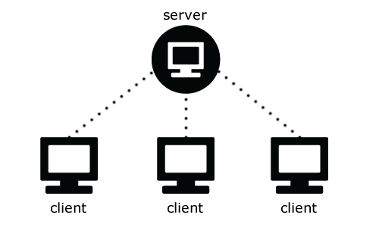
{" WHAT IS JSON ? ":[
{"num":1", "expr":" {"JSON is a syntax for storing and exchanging data. "},
{"num":2", "expr":" {"JSON is an easier-to-use alternative to XML. "},
{"num":3", "expr":" {"JSON is lightweight format for exchanging data b/w the client and server."},
{"num":4", "expr":" {"JSON is not a Programing Language"},
{"num":5", "expr":" {" JSON is Subset of JavaScript "},
]}
Cmpe 422 – Database Systems 2017 Fall

Slide 5

History of JSON?
Cmpe 422 – Database Systems 2017 Fall

Slide 6
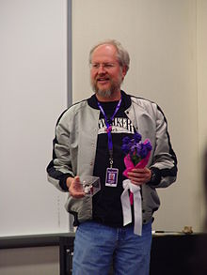
Douglas Crockford in 2001
2002 JSON.org
2005 Ajax
2006 RFC 4627
Cmpe 422 – Database Systems 2017 Fall

Slide 7
What we use JSON?
Cmpe 422 – Database Systems 2017 Fall

Slide 8
{" WHAT WE USE JSON ? ":[
{"num":1", "expr":" {"Straightforward Syntax"},
{"num":2", "expr":" {"Easy To Create And Manipulate "},
{"num":3", "expr":" {"Can Be Natively Parsed In Javascript Using Eval() "},
{"num":4", "expr":" {"Supported By All Major Javascript Frameworks "},
{"num":4", "expr":" {" Supported By Most Backend Technologies "},
]}
Cmpe 422 – Database Systems 2017 Fall

Slide 9

JSON is NOT…
Cmpe 422 – Database Systems 2017 Fall

Slide 10
JSON is NOT…
• JSON is not a document format.
• JSON is not a markup language.
• JSON is not a general serialization format.
No cyclical/recurring structures.
No invisible structures.
No functions.
Cmpe 422 – Database Systems 2017 Fall

Slide 11
JSON OBJECTS
A JSON object is an unordered set of name/value pairs inserted between {} (curly braces)
{ "artistname" : "Deep Purple" }
Cmpe 422 – Database Systems 2017 Fall

Slide 12
{ }
{ "artistname" : "Deep Purple" }
{
"artistname" : "Deep Purple",
"formed" : "1968"
}
{
"artistname" : "Deep Purple",
"formed" : "1968",
"origin" : "Hertford, United Kingdom"
}
In JSON, a name is a string. Its value can be an object, array, number, string, true, false, or null.
Cmpe 422 – Database Systems 2017 Fall

Slide 13
JSON ARRAYS
{
"artists" : [
{
"artistname" : "Deep Purple",
"formed" : "1968"
},
{
"artistname" : "Joe Satriani",
"born" : "1956"
},
{
"artistname" : "Maroon 5",
"formed" : "1994"
}
]
}
Cmpe 422 – Database Systems 2017 Fall

Slide 14
NESTED DATA
{
"artists" : [
{
"artistname" : "Deep Purple",
"formed" : "1968",
"albums" : [
{
"albumname" : "Machine Head",
"year" : "1972",
"genre" : "Rock"
},
{
"albumname" : "Stormbringer",
"year" : "1974",
"genre" : "Rock"
}
]
}
]
}
Cmpe 422 – Database Systems 2017 Fall

Slide 15
JSON Data Types
String
Number
Boolean
Null
Object
Array
Cmpe 422 – Database Systems 2017 Fall

Slide 16
JSON Data Types
Data Type | Description
String | Any sequence of Unicode code points, inserted between " and " (double quotes). Some characters may need to be escaped
Number | Represented in base 10 with no superfluous leading zero. Can include digits between 0 and 9. It can be a negative number (e.g. -10. It can be a fraction (e.g. .5). It can also have an exponent of 10, prefixed by e, E, +, or -.
Boolean | This can be either true or false.
Null | Empty.
Cmpe 422 – Database Systems 2017 Fall

Slide 17
JSON Data Types
Data Type | Description
Object | A JSON object is an unordered set of name/value pairs inserted between {} (curly braces). An object can contain zero or more name/value pairs. Multiple name/value pairs are separated by a , (comma).
Array | A JSON array is an ordered collection of values. It allows you to provide a list of values. A JSON array begins with [ (left bracket) and ends with ] (right bracket). Its values are separated by , (comma).
Cmpe 422 – Database Systems 2017 Fall

Slide 18
Escape Characters
Character | Unicode Name/Code Point | Use this to escape it
" | Quotation mark (U+0022 ) | \"
\ | Reverse solidus (U+005C ) | \\
/ | Solidus (U+002F ) | \/
 | Backspace (U+0008 ) | \b
 | Form feed (U+000C ) | \f
 | Line feed (U+000A ) | \n
 | Carriage return (U+000D ) | \r
 | Horizontal tab (U+0009 ) | \t
Cmpe 422 – Database Systems 2017 Fall

Slide 19
{
"artists" : [
{
"artistname" : "Deep Purple",
"formed" : "1968"
},
{
"artistname" : "Joe Satriani",
"born" : "1956-07-15"
},
{
"artistname" : "Maroon 5",
"formed" : "1994"
}
]
}
JSON has no rule to say that certain objects must use a certain data type, or even contain the same fields. They don't even need to contain the same number of fields.
Cmpe 422 – Database Systems 2017 Fall

Slide 20
"born" : "1956"
"born" : 1956
"born" : "July 15, 1956"
"born" : "1956-07-15"
"born" : "07/15/1956"
"born" : "15/07/1956"
"born" : "I like oranges!"
"born" : [
{
"albumname" : "Flying in a Blue Dream",
"year" : "1989",
"genre" : "Instrumental Rock"
},
{
"albumname" : "Shockwave Supernova",
"year" : "2015",
"genre" : "Instrumental Rock"
}
]
"born" : "Oooops!!!"
Cmpe 422 – Database Systems 2017 Fall

Slide 21
Creating a Schema
You can apply rules to your JSON files by creating a schema. A JSON Schema allows you to specify what type of data can go into your JSON files.
You can use a schema to validate the JSON file to ensure it contains only the correct type of data.
{ "type": "string" }
Cmpe 422 – Database Systems 2017 Fall

Slide 22
To Declare a JSON Schema
The JSON Schema is in fact, JSON itself. So it's not always easy to tell whether you're looking at a JSON Schema or just an ordinary JSON document.
To declare a JSON Schema, use the $schema keyword.
{ "$schema": "http://json-schema.org/schema#" }
Cmpe 422 – Database Systems 2017 Fall

Slide 23
Arrays vs Objects
Use objects when the key names are arbitrary strings.
Use arrays when the key names are sequential integers.
Cmpe 422 – Database Systems 2017 Fall

Slide 24
JSON | XML
JSON object are | type XML data is typeless
JSON types: string, number, array, boolean | XML data are all string
Data is readily accessible as JSON objects | XML data needs to be parsed
Retrieving value is easy | Retrieving value is difficult
JSON is supported by all browsers | Cross browser XML parsing can be tricky
Simple API | Complex API
Supported by many Ajax toolkit | Not fully supported by Ajax toolkit
Fast object de-serialization in JavaScript | Slower de-serialization in JavaScript
Fully automated way of deserializing/ serializing JavaScript objects | Developers have to write JavaScript code to serialize/de-serialize to/from XML

Slide 25
Pros | Cons
Fast to parse | No namespace support, hence poor extensibility
Good support for all browsers | Limited development tools support
Supported by many languages | No support for formal grammar definition
Concise format: name/value pair - based approach | Retrieving value is difficult
Easy to read | Cross browser XML parsing can be tricky
Easy to write | Complex API

Slide 26
Cmpe 422 – Database Systems 2017 Fall

Slide 27
The relational model was brought by E.F. Codd’s 1970 paper which made data modeling and application programming much easier.
After the arrival of web 2.0 applications, data stores need to large scale OLTP /OLAP application loads. In this circumstance, the relational model does not provide good results. This is the gap which NoSQL systems attempt to fill, by providing a more scalable solution with high availability.
Cmpe 422 – Database Systems 2017 Fall

Slide 28
History of CASSANDRA?
Cmpe 422 – Database Systems 2017 Fall

Slide 29
History of CASSANDRA?
Cmpe 422 – Database Systems 2017 Fall

Slide 30
WHAT IS EVENTUALLY CONSISTENT?
Building reliable distributed systems on a global scale demands trade-offs between consistency and availability .Consistency in a nutshell means that when something is written, it is expected that all reads after the write will have access to that written data. In Cassandra, due to its distributed nature, there are no such hard guarantees. However, we can say that it eventually reaches a consistent state because all data is eventually replicated across the distributed data store.
Cmpe 422 – Database Systems 2017 Fall

Slide 31
The CAP theorem visualized as a Venn diagram.
NOSQL systems and CAP Model
Cmpe 422 – Database Systems 2017 Fall

Slide 32
USERS
• Twitter is using Cassandra for analytics.
• Mahalo uses it for its primary near-time data store.
• Facebook still uses it for inbox search, though they are using a proprietary fork.
• Digg uses it for its primary near-time data store.
• Rackspace uses it for its cloud service, monitoring, and logging.
• Reddit uses it as a persistent cache.
• Cloudkick uses it for monitoring statistics and analytics.
• Ooyala uses it to store and serve near real-time video analytics data.
• SimpleGeo uses it as the main data store for its real-time location infrastructure.
• Onespot uses it for a subset of its main data store.
Cmpe 422 – Database Systems 2017 Fall

Slide 33
ARCHITECTURE
Cassandra was developed as a peer to peer distributed system where all nodes serve the same functions, meaning there is no single point of failure.
One of Cassandra’s greatest strength is its availability and scaling, it achieves this through a fully distributed system where data is replicated across multiple nodes according to user settings.
Cmpe 422 – Database Systems 2017 Fall

Slide 34
Cassandra write cycle as shown by Netflix’s Cassandra production rollout team.
Cmpe 422 – Database Systems 2017 Fall

Slide 35
Strengths of Cassandra
• Gigabyte to Petabyte scalability
• Flexible Schema Design
• Linear Performance of gains through node addition
• Cassandra Query Language (like SQL)
• Data Compression
• No need for separate caching layer
• Tunable data consistency
Cmpe 422 – Database Systems 2017 Fall

Slide 36
Data Model
Cmpe 422 – Database Systems 2017 Fall

Slide 37
CLUSTER
It is not probably the best choice if you only have one node in Cassandra. Usually a user creates several nodes that will form a ring and uses a peer-to-peer protocol for data replication. So in case of one node going down the node having the data replica responds to the query. The ring is the outer most structure in Cassandra. They call this ring cluster.
Cmpe 422 – Database Systems 2017 Fall

Slide 38
KEYSPACES
The key space is the outermost container for data in Cassandra. It resembles the database in relational database. A cluster can hold several key spaces. In Cassandra when you create key space there are set of basic attributes you can set for it as follow:
a) Replication Factor: The number of nodes holding the replica of data
b) Replica Placement Strategy: The strategy the replication should happen
c) Column Families: Like a database having several tables a Keyspace can define many column families
Cmpe 422 – Database Systems 2017 Fall

Slide 39
COLUMN
The basic building block in Cassandra is a column. The column is constructed of three parts: column name, column value and a timestamp. The column name and value are simply saved as Java byte arrays. The timestamp is implementation of Cassandra IClock interface. The timestamp is used for internal Cassandra use and is not accessible or editable by the user.
{
"name": "email",
"value: "me@example.com",
"timestamp": 1274654183103300
}
Cmpe 422 – Database Systems 2017 Fall

Slide 40
COLUM FAMILY
The column family resembles the table in a relational database.
Cassandra is considered schema free.
A column family has two attributes: a name and a comparator.
The comparator value indicates how columns will be sorted when they are returned to you in a query—according to long, byte, UTF8, or other ordering.
A collection of these columns constitutes a row in Cassandra. The primary key or unique identifier of each row will be called row-key. So a column family will be number of rows and each row can have variable length of columns. In Cassandra the design of many aspects including the data model concentrates on performance so anything that could help better performance has been considered such as variable length of columns.
Cmpe 422 – Database Systems 2017 Fall

Slide 41
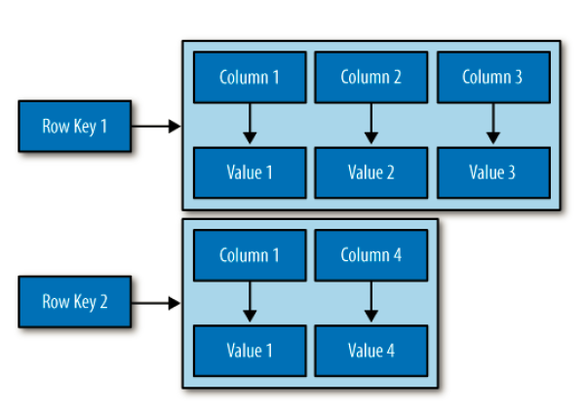
A COLUMN FAMILY IN CASSANDRA
Cmpe 422 – Database Systems 2017 Fall

Slide 42
Cmpe 422 – Database Systems 2017 Fall

Slide 43
Pros | Cons
Write Speed | No Ad-Hoc Queries
Multi-DC Replication | No Aggregations
Tunable Consistency | Unpredictable Performance:
JVM Based: | JVM Based
CQL | CQL

Slide 44
REFERENCES
https://www.json.org/json-en.html
http://www.json.org/json.pdf
http://www.csc.kth.se/utbildning/kth/kurser/DD143X/dkand11/Group2Mads/victor.hallberg.malin.eriksson.report.pdf
http://tinman.cs.gsu.edu/~bjayakumar2/Final/report.pdf
http://www.oracle.com/technetwork/products/nosqldb/documentation/nosql-vs-cassandra-1961717.pdf
https://www.datastax.com/wp-content/uploads/2012/08/WP-IntrotoCassandra.pdf
http://ftp.esrf.eu/pub/cs/tango/meetings/2015_may_solaris/Reynald_Bourtembourg_HDB++_-_High_availability_with_Cassandra.pdf

